Slide 1
Parallel Computing
Threads and OpenMP

Slide 2
Outline
Shared Memory Hardware
Parallel Programming with Threads
Parallel Programming with OpenMP
See http://www.nersc.gov/nusers/help/tutorials/openmp/
Summary

Slide 3
Parallel Programming in OpenMP: Work-sharing Construct

Slide 4
Work-sharing Construct
#pragma omp parallel
#pragma omp for for (I=0;I<N;I++){ Do_Work(I); }
Splits loop iterations into threads
Must be in the parallel region
Must precede the loop
loop construct
sections construct
single construct

Slide 5
Parallel Sections
Independent sections of code can execute concurrently
#pragma omp parallel sections
{
#pragma omp section
phase1();
#pragma omp section
phase2();
#pragma omp section
phase3();
}
Serial
Parallel
Notes:
Sections are distributed among the threads in the parallel team. Each section is executed only once and each thread may execute zero or more sections. It’s not possible to determine whether or not a section will be executed before another. Therefore, the output of one section should not serve as the input to another. Instead, the section that generates output should be moved before the sections construct.

Slide 6
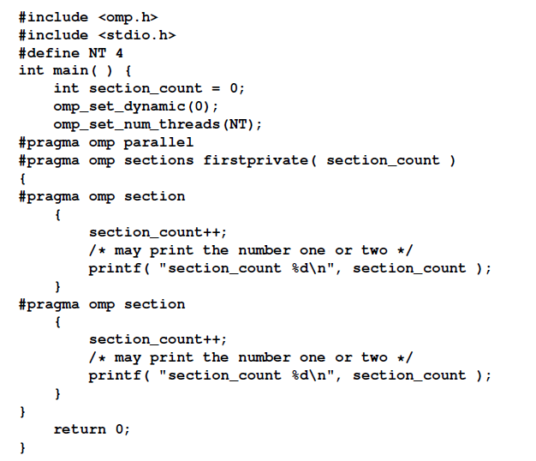
section_count 1
section_count 1

Slide 7
section 1 ThreadId = 0
section 2 ThreadId = 2
section 4 ThreadId = 3
section 3 ThreadId = 1
void main(int argc, char *argv)
{
#pragma omp parallel sections
{
#pragma omp section
printf(“section 1 ThreadId = %d\n”, omp_get_thread_num());
#pragma omp section
printf(“section 2 ThreadId = %d\n”, omp_get_thread_num());
#pragma omp section
printf(“section 3 ThreadId = %d\n”, omp_get_thread_num());
#pragma omp section
printf(“section 4 ThreadId = %d\n”, omp_get_thread_num());
}
}

Slide 8
section 1 ThreadId = 0
section 2 ThreadId = 1
section 4 ThreadId = 1
Section 3 ThreadId = 0
void main(int argc, char *argv)
{
#pragma omp parallel
{
#pragma omp sections
{
#pragma omp section
printf(“section 1 ThreadId = %d\n”, omp_get_thread_num());
#pragma omp section
printf(“section 2 ThreadId = %d\n”, omp_get_thread_num());
}
#pragma omp sections
{
#pragma omp section
printf(“section 3 ThreadId = %d\n”, omp_get_thread_num());
#pragma omp section
printf(“section 4 ThreadId = %d\n”, omp_get_thread_num());
}
}
}

Slide 9
Single Construct
Denotes block of code to be executed by only one thread
First thread to arrive is chosen
Implicit barrier at end
#pragma omp parallel
{
DoManyThings();
#pragma omp single
{
ExchangeBoundaries();
} // threads wait here for single
DoManyMoreThings();
}

Slide 10
Master Construct
Denotes block of code to be executed only by the master thread
No implicit barrier at end
#pragma omp parallel
{
DoManyThings();
#pragma omp master
{ // if not master skip to next stmt
ExchangeBoundaries();
}
DoManyMoreThings();
}

Slide 11
Implicit Barriers
Several OpenMP* constructs have implicit barriers
parallel
for
single
Unnecessary barriers hurt performance
Waiting threads accomplish no work!
Suppress implicit barriers, when safe, with the nowait clause

Slide 12
Work-sharing Construct
#pragma omp parallel
#pragma omp for
for(i = 1, i < 13, i++)
c[i] = a[i] + b[i]
#pragma omp parallel
#pragma omp for
i = 1
i = 2
i = 3
i = 4
i = 5
i = 6
i = 7
i = 8
i = 9
i = 10
i = 11
i = 12
Threads are assigned an independent set of iterations
Threads must wait at the end of work-sharing construct
Implicit barrier

Slide 13
Loop worksharing Constructs
A motivating example
for(i=0;i<N;i++) { a[i] = a[i] + b[i];}
Sequential code
for(i=0;i<N;i++) { a[i] = a[i] + b[i];}
#pragma omp parallel
{
int id, i, Nthrds, istart, iend;
id = omp_get_thread_num(); Nthrds = omp_get_num_threads(); istart = id * N / Nthrds;
iend = (id+1) * N / Nthrds;
if (id == Nthrds-1)iend = N;
for(i=istart;i<iend;i++) { a[i] = a[i] + b[i];}
}
#pragma omp parallel
{
int id, i, Nthrds, istart, iend;
id = omp_get_thread_num(); Nthrds = omp_get_num_threads(); istart = id * N / Nthrds;
iend = (id+1) * N / Nthrds;
if (id == Nthrds-1)iend = N;
for(i=istart;i<iend;i++) { a[i] = a[i] + b[i];}
}
OpenMP parallel region
OpenMP parallel region and a worksharing for construct
#pragma omp parallel
#pragma omp for
for(i=0;i<N;i++) { a[i] = a[i] + b[i];}
#pragma omp parallel
#pragma omp for
for(i=0;i<N;i++) { a[i] = a[i] + b[i];}
76

Slide 14
Combining pragmas
These two code segments are equivalent
#pragma omp parallel
{
#pragma omp for
for (i=0;i< MAX; i++) { res[i] = huge();
}
}
#pragma omp parallel for
for (i=0;i< MAX; i++) {
res[i] = huge();
}

Slide 15
Loop Construct
The syntax of the loop construct is as follows:
#pragma omp for [clause[ [,] clause] ... ] new-line
for-loops
where clause is one of the following:
private(list)
firstprivate(list)
lastprivate(list)
linear(list[ : linear-step])
reduction(reduction-identifier : list)
schedule([modifier [, modifier]:]kind[, chunk_size])
collapse(n)
ordered[(n)]
Nowait

Slide 16
NO WAIT / nowait: If specified, then threads do not synchronize at the end of the parallel loop.
ORDERED: Specifies that the iterations of the loop must be executed as they would be in a serial program.
COLLAPSE: Specifies how many loops in a nested loop should be collapsed into one large iteration space and divided according to the schedule clause. The sequential execution of the iterations in all associated loops determines the order of the iterations in the collapsed iteration space.
Notes:
The ordered clause with the parameter may also be used to specify how many loops are associated with the loop construct.

Slide 17
The schedule clause specifies
how iterations of these associated loops are divided into contiguous non-empty subsets, called chunks, and how these chunks are distributed among threads of the team.
Static: schedule(static, chunk_size)
divided into chunks of size chunk_size, and the chunks are assigned to the threads in the team in a round-robin fashion in the order of the thread number.
Dynamic: schedule(dynamic, chunk_size)
. Each thread executes a chunk of iterations, then requests another chunk, until no chunks remain to be distributed.
Guided: schedule(guided, chunk_size)
Each thread executes a chunk of iterations, then requests another chunk, until no chunks remain to be assigned.
RUNTIME
The scheduling decision is deferred until runtime by the environment variable OMP_SCHEDULE. It is illegal to specify a chunk size for this clause.
AUTO
The scheduling decision is delegated to the compiler and/or runtime system.
Notes:
When schedule(static, chunk_size) is specified, iterations are
divided into chunks of size chunk_size, and the chunks are assigned to
the threads in the team in a round-robin fashion in the order of the thread
number.
When no chunk_size is specified, the iteration space is divided into chunks
that are approximately equal in size, and at most one chunk is distributed to
each thread. The size of the chunks is unspecified in this case.

Slide 18
loop work-sharing constructs: The schedule clause
Schedule Clause | When To Use
STATIC | Pre-determined and predictable by the programmer
DYNAMIC | Unpredictable, highly variable work per iteration
GUIDED | Special case of dynamic to reduce scheduling overhead
AUTO | When the runtime can “learn” from previous executions of the same loop
Least work at runtime : scheduling done at compile-time
Least work at runtime : scheduling done at compile-time
Most work at runtime : complex scheduling logic used at run-time
Most work at runtime : complex scheduling logic used at run-time
78

Slide 19
Working with loops
Basic approach
Find compute intensive loops
Make the loop iterations independent .. So they can safely execute in any order without loop-carried dependencies
Place the appropriate OpenMP directive and test
Note: loop index “i” is private by default
int i, j, A[MAX]; j = 5;
for (i=0;i< MAX; i++) {
j +=2;
A[i] = big(j);
}
int i, A[MAX];
#pragma omp parallel for
for (i=0;i< MAX; i++) { int j = 5 + 2*(i+1); A[i] = big(j);
}
Remove loop carried dependence

Slide 20
Nested loops
For perfectly nested rectangular loops we can parallelize
multiple loops in the nest with the collapse clause:
#pragma omp parallel for collapse(2)
for (int i=0; i<N; i++) {
Number of loops to be parallelized, counting from the outside
for (int j=0; j<M; j++) {
Number of
loops to be
.....
parallelized,
}
counting from
}
the outside
Will form a single loop of length NxM and then
parallelize that.
Useful if N is O(no. of threads) so parallelizing the outer loop makes balancing the load difficult.
81

Slide 21
example：
int i, j;
int a[100][100] = {0};
for ( i =0; i < 100; i++)
{
for( j = i; j < 100; j++ )
{
a[i][j] = i*j;
}
}
If the outer loop is paralleled, such as using 4 threads, there is 100 times computing difference when I is 0 and I is 99 respectively, then each thread may appear larger load imbalance.
The schedule clause specifies
how iterations of these associated loops are divided into contiguous non-empty subsets, called chunks, and how these chunks are distributed among threads of the team. Each thread executes its assigned chunk(s) in the context of its implicit task.

Slide 22
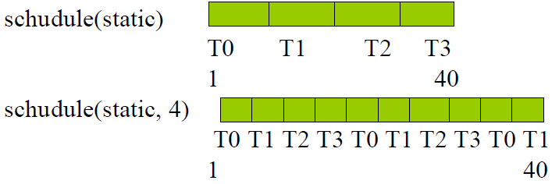
Static schedule
schedule Clause : schedule (STATIC [, size]）
no chunk_size is specified
the iteration space is divided into chunks that are approximately equal in size
chunk_size is specified
iterations are divided into chunks of size chunk_size􀀹
example：thread_num is 4

Slide 23

schedule (DYNAMIC[, size]）:􀂋
the iterations are distributed to threads in the team in chunks.
Each thread executes a chunk of iterations, then requests another chunk, until no chunks remain to be distributed.
no chunk_size is specified, it defaults to 1.
schedule (GUIDED[, chunksize]）
Each thread executes a chunk of iterations, then requests another chunk, until no chunks remain to be assigned.
Where N is the number of theads，Sk is the size of the kth chunk，Rk is the number of remaining iterations。􀂋

Slide 24
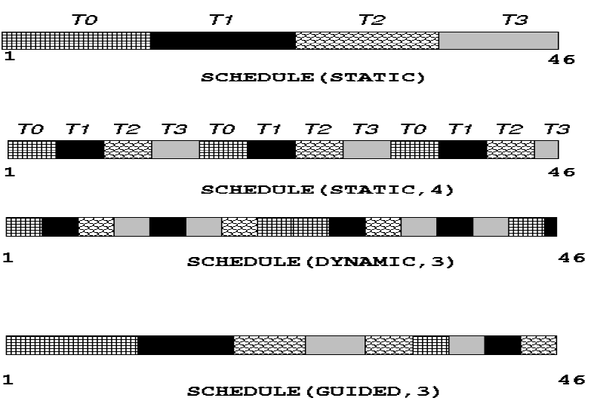
SCHEDULE example

Slide 25
parallel for vector sum
#include <omp.h> //ex2
#define N 1000
#define CHUNKSIZE 100
int main () {
int i, chunk;
float a[N], b[N], c[N];
/* Some initializations */
for (i=0; i < N; i++)
a[i] = b[i] = i * 1.0;
chunk = CHUNKSIZE;
#pragma omp parallel for \
shared(a,b,c,chunk) private(i) \
schedule(static,chunk)
for (i=0; i <N; i++) {
c[i] = a[i] + b[i];
}
}

Slide 26
Reduce
How do we handle this case?
double ave=0.0, A[MAX]; int i;
for (i=0;i< MAX; i++) {
ave + = A[i];
}
ave = ave/MAX;
We are combining values into a single accumulation variable (ave) … there is a true dependence between loop iterations that can’t be trivially removed
This is a very common situation … it is called a
“reduction”.
Support for reduction operations is included in most parallel programming environments.
82

Slide 27
Reduction
OpenMP reduction clause: reduction (op : list)
Inside a parallel or a work-sharing construct:
A local copy of each list variable is made and initialized
depending on the “op” (e.g. 0 for “+”).
Updates occur on the local copy.
Local copies are reduced into a single value and combined with the original global value.
The variables in “list” must be shared in the enclosing
parallel region.
double ave=0.0, A[MAX]; int i;
#pragma omp parallel for reduction (+:ave) for (i=0;i< MAX; i++) {
ave + = A[i];
}
ave = ave/MAX;
83

Slide 28
OpenMP: Reduction operands/initial-values
Many different associative operands can be used with reduction:
Initial values are the ones that make sense mathematically.
Operator | Initial value
+ | 0
* | 1
- | 0
min | Largest pos. number
max | Most neg. number
Fortran Only
Operator | Initial value
.AND. | .true.
.OR. | .false.
.NEQV. | .false.
.IEOR. | 0
.IOR. | 0
.IAND. | All bits on
.EQV. | .true.
C/C++ only
Operator | Initial value
& | ~0
| | 0
^ | 0
&& | 1
|| | 0
84

Slide 29
Parallel Programming in OpenMP: Synchronization Construct

Slide 30

Synchronization
Synchronization: bringing one or more threads to a well defined and
known point in their execution.
The two most common forms of synchronization are:
Barrier: each thread wait at the barrier until all threads arrive.
61/61
Mutual exclusion: Define a block of code that only one thread at a time can execute.

Slide 31
Synchronization
Synchronization is used to impose order constraints
and to protect access to shared data
High-Level Synchronization
critical
atomic
barrier
ordered
Low-Level Synchronization
locks

Slide 32
Data race
example：
Serial progam
Int i, max_num=1;
for (i=0;i<n;i++)
if (ar[i]>max_num)
max_num=ar[i];
Using openmp：
int i, max_num=1;
#pragma omp parallel for
for (i=0;i<n;i++)
if (ar[i]>max_num)
max_num=ar[i];
X

Slide 33
Synchronization: Barrier
Barrier: Each thread waits until all threads arrive.
#pragma omp parallel
{
int id=omp_get_thread_num(); A[id] = big_calc1(id);
#pragma omp barrier
B[id] = big_calc2(id, A);
}
63

Slide 34

Synchronization: Critical/Atomic Directives
When each thread must execute a section of code serially the region must be marked with critical/end critical directives
Use the #pragma omp atomic directive if executing only one operation
serially
#pragma
...
#pragma
{
omp parallel shared(sum,x,y)
omp critical
#pragma omp parallel
...
{
#pragma omp atomic
sum=sum+1;
...
}
shared(sum)
update(x); update(y); sum=sum+1;
Read
Write
Update
capture
}
...
time
Master Thread
CRITICAL section or atomic operations
30
Notes:
The atomic construct ensures that a specific storage location is accessed atomically, rather than exposing it to the possibility of multiple, simultaneous reading and writing threads that may result in indeterminate values.
#pragma omp atomic
X<binop>=expr
#pragma omp atomic
X++//or x--,--x,++x
+ * -/& ^|<<>>

Slide 35
Synchronization: Atomic (basic form)
Atomic provides mutual exclusion but only applies to the update of a memory location (the update of X in the following example)
The statement inside the atomic must be one of the following forms:
x binop= expr
• x++
• ++x
x—
• --x
X is an lvalue of scalar type and binop is a non-overloaded built in operator.
#pragma omp parallel
{
double tmp, B;
B = DOIT();
tmp = big_ugly(B);
#pragma omp atomic
X += tmp;
}
Additional forms of atomic were added in OpenMP 3.1.
65

Slide 36
Synchronization: Barrier
Barrier: Each thread waits until all threads arrive
#pragma omp parallel shared (A,
{
id=omp_get_thread_num();
B, C) private(id)
A[id] =
#pragma
#pragma
big_calc1(id); omp barrier omp for
for(i=0;i<N;i++){
C[i]=big_calc3(i,A);
}
#pragma omp for nowait
for(i=0;i<N;i++){
Implicit barrier
B[i]=big_calc2(C, i);
}
A[id] = big_calc4(id);
No implicit barrier due to nowait
}
Implicit barrier

Slide 37
Synchronization: Ordered
The ordered region executes in the sequential order
#pragma omp parallel private (tmp)
#pragma omp for ordered reduction(+:count) for (i=0;i<N;i++){
tmp = foo(i);
#pragma omp ordered
count += consume(tmp);
}

Slide 38
NOWAIT
When a work-sharing region is exited, a barrier is implied - all threads must reach the barrier before any can proceed.
#pragma
{
#pragma
{
omp parallel
omp for nowait
for (i=0; i<n; i++)
{work(i);}
By using the NOWAIT clause at the end of each loop inside the parallel region, an unnecessary synchronization of threads can be avoided.
}
#pragma omp for schedule(dynamic,k)
{
for (i=0; i<m; i++)
{x[i]=y[i]+z[i];}
}
}

Slide 39
Parallel Programming in OpenMP: tasks Construct

Slide 40
list traversal
When we first created OpenMP, we focused on common use cases in HPC … Fortran arrays processed over “regular” loops.
Recursion and “pointer chasing” were so far removed from our Fortan focus that we didn’t even consider more general structures.
Hence, even a simple list traversal is exceedingly difficult
with the original versions of OpenMP.
p=head; while (p) {
process(p); p = p->next;
}
127

Slide 41
Linked lists without tasks
while (p != NULL) { p = p->next; count++;
}
p = head;
for(i=0; i<count; i++) { parr[i] = p;
p = p->next;
}
#pragma omp parallel
{
#pragma omp for schedule(static,1)
for(i=0; i<count; i++)
processwork(parr[i]);
}
Count number of items in the linked list
Copy pointer to each node into an array
Process nodes in parallel with a for loop
 | Default schedule | Static,1
One Thread | 48 seconds | 45 seconds
Two Threads | 39 seconds | 28 seconds
Results on an Intel dual core 1.83 GHz CPU,
Intel IA-32 compiler 10.1 build 2
128

Slide 42
What are tasks?
Tasks are independent units of work
Tasks are composed of:
code to execute
data to compute with
Threads are assigned to perform the work of each task.
The thread that encounters the task construct may execute the task immediately.
The threads may defer execution until later
The task construct includes a structured block of code
Inside a parallel region, a thread encountering a task construct will package up the code block and its data for execution
Tasks can be nested: i.e. a task may itself generate tasks.
Serial
Parallel

Slide 43
When are tasks guaranteed to complete
Tasks are guaranteed to be complete at thread barriers:
#pragma omp barrier
or task barriers
#pragma omp taskwait
#pragma omp parallel
{
Multiple foo tasks created
here – one for each thread
#pragma omp task
foo();
#pragma omp
#pragma omp
barrier single
All foo tasks guaranteed to
be completed here
{
#pragma
bar();
omp task
One bar task created here
}
}
bar task guaranteed to be
completed here

Slide 44
The task construct (OpenMP 4.5)
#pragma omp task [clause[[,]clause]...] structured-block
Generates an explicit task
where clause is one of the following:
if([ task :]scalar-expression) untied
default(shared | none) private(list) firstprivate(list) shared(list)
final(scalar-expression)
The evolution of the task construct
OpenMP 3.0 (May’08)
OpenMP 3.1 (Jul’11)
OpenMP 4.0 (Jul’13)
OpenMP 4.5 (Nov’15)
mergeable depend(dependence-type : list)
priority(priority-value)

Slide 45
The task construct (OpenMP 4.5)
#pragma omp task [clause[[,]clause]...] structured-block
Generates an explicit task
where clause is one of the following:
if([ task :]scalar-expression) untied
default(shared | none) private(list)
The evolution of the task construct
Consider the data
OpenMP 3.0
OpenMP 3.1
firstprivate(list) shared(list)
environment associated
with a task
OpenMP 4.0
OpenMP 4.5
final(scalar-expression)
mergeable depend(dependence-type : list)
priority(priority-value)

Slide 46
Data scoping with tasks
Variables can be shared, private or firstprivate with respect to task
These concepts are a little bit different compared with threads:
If a variable is shared on a task construct, the references to it inside the construct are to the storage with that name at the point where the task was encountered
If a variable is private on a task construct, the references to it inside the construct are to new uninitialized storage that is created when the task is executed
If a variable is firstprivate on a construct, the references to it inside the construct are to new storage that is created and initialized with the value of the existing storage of that name when the task is encountered

Slide 47
Data scoping defaults
The behavior you want for tasks is usually firstprivate, because the task may not be executed until later (and variables may have gone out of scope)
– Variables that are private when the task construct is encountered are firstprivate by default
Variables that are shared in all constructs starting from the inner most enclosing parallel construct are shared by default
#pragma omp parallel
{
...
#pragma
{
shared(A)
private(B)
omp task
A is shared
B is firstprivate
C is private
int C; compute(A,
B, C);
}
}

Slide 48
Example: Fibonacci numbers
int fib (int n)
{
int x,y;
if (n < 2) return n;
x = fib(n-1);
y = fib (n-2); return (x+y);
}
Int main()
{
int NW = 5000;
fib(NW);
}
^{F}n ^{= F}n-1 ^{+ F}n-2
Inefficient O(n²) recursive implementation!

Slide 49
Data Scoping with tasks: Fibonacci example.
This is an instance of the
int fib ( int n )
{
divide and conquer design pattern
n is private in both tasks
int x,y;
if ( n < 2 ) return n;
#pragma omp task
x = fib(n-1);
#pragma omp task y = fib(n-2);
#pragma omp taskwait return x+y
x is a private variable y is a private variable
}
What’s wrong here?
A task’s private variables are
undefined outside the task

Slide 50
Data Scoping with tasks: Fibonacci example.
int fib ( int n )
{
int x,y;
if ( n < 2 ) return n;
#pragma omp task shared (x)
x = fib(n-1);
#pragma omp task shared(y) y = fib(n-2);
#pragma omp taskwait
return x+y;
}
n is private in both tasks
x & y are shared
Good solution
we need both values to compute the sum

Slide 51
Parallel Fibonacci
int fib (int n)
{ int x,y;
if (n < 2) return n;
#pragma omp task shared(x)
x = fib(n-1);
#pragma omp task shared(y)
y = fib (n-2);
#pragma omp taskwait
return (x+y);
}
Int main()
{ int NW = 5000;
#pragma omp parallel
{
#pragma omp master fib(NW);
}
}
Binary tree of tasks
Traversed using a recursive function
A task cannot complete until all tasks below it in the tree are complete (enforced with taskwait)
x,y are local, and so by default they are private to current task
– must be shared on child tasks so they don’t create their own firstprivate copies at this level!

Slide 52
Data Scoping with tasks: List Traversal example
List ml; //my_list Element *e;
#pragma omp parallel
#pragma omp single
{
for(e=ml->first;e;e=e->next)
#pragma omp task
process(e);
What’s wrong here?
}
Possible data race !
Shared variable e
updated by multiple tasks

Slide 53
Data Scoping with tasks: List Traversal example
List ml; //my_list
Element
#pragma
#pragma
{
*e;
omp parallel
omp single
for(e=ml->first;e;e=e->next)
#pragma omp task firstprivate(e)
process(e);
}
Good solution – e is
firstprivate
Good solution – e is firstprivate

Slide 54
Task Construct – Explicit Tasks
1. Create
a team of
#pragma omp parallel
threads.
{
#pragma omp single
2. One thread executes the single construct
{
3. The “single” thread
node * p = head;
while (p) {
creates a task with its own
value for the pointer p
… other threads
wait at the implied
#pragma omp task firstprivate(p) process(p);
p = p->next;
barrier at the end of the single construct
}
}
4. Threads waiting at the barrier execute
tasks.
}
Execution moves beyond the barrier once all the tasks are complete

Slide 55



Execution of tasks
Have potential to parallelize irregular patterns and recursive function calls
#pragma omp parallel
{
#pragma omp single
Single
Threaded
Thr1 Thr2 Thr3 Thr4
Block 1
Block 2 Task 1
Block 1
{ //block 1 node * p = head;
while (p) { // block 2
#pragma omp task
process(p);
p = p->next; //block 3
}
Block 2
Task 1
Block 2 Task 2
Block 3
Block 2 Task 3
Idle
Idle
Block 2 Task 2
Time
}
Block 3
Time Saved
}
Block 2
Task 3

